Slide 1
Survey and Investigation of Buildings Damaged by Category III, IV and V Hurricanes in FY 2022-2023 Hurricane Idalia - 28 August 2023
Interim Report
Investigators:
David O. Prevatt , Ph.D., PE & Kurtis Gurley, Ph.D., (University of Florida)
David B. Roueche , Ph.D. (Auburn University)
Sponsor: Florida Building Codes and Standards (Florida DBPR)
Project Manager: Mo Madani
17 October 2023

Slide 2
Acknowledgements
Dr. Christopher Ferraro, Associate Professor University of Florida
Dr. Brian Phillips, Associate Professor University of Florida
Dr Forrest Masters, Professor and Interim Dean,
Herbert Wertheim College of Engineering, University of Florida
Sean A. Robinson, Civil Engineering Student, Univ. of Florida
Giorgio Carmagnani, Civil Engineering Student, Univ. of Florida
Johnathon Santo Micali, Civil Engineering Student, Univ. of Florida

Slide 3
Agenda:
Hurricane Idalia Summary (wind, surge, rainfall, tornadoes)
Florida Building Code Modifications
Design Wind Speed
CCCL Lines
Triage Building Performance Assessment by UF
Deployment
Initial Triage Assessment of Building Performance
Formal Surveys (with StEER and others)
Enrichment of Reconnaissance Data
Summary
Questions and Comments?

Slide 4
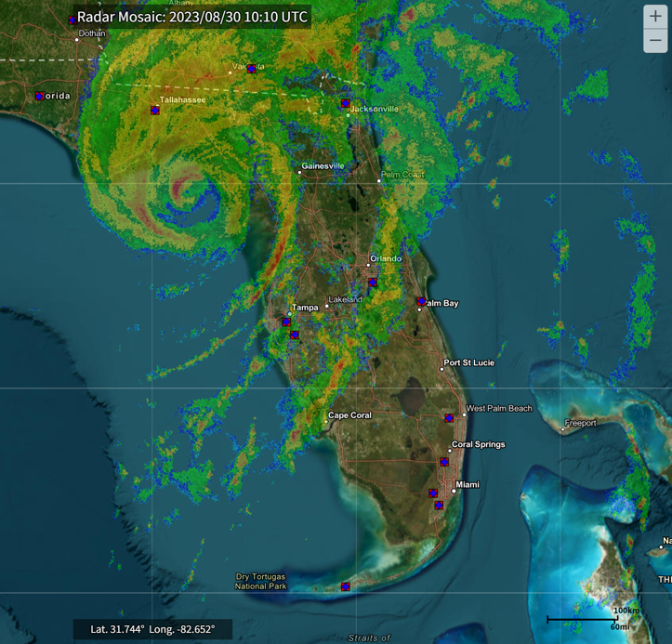
Hurricane Idalia (2023) Summary
Landfall Date | 30-August 2023
Landfall Location | Kenton Beach, FL
Landfall Intensity | Category 3
Max Sustained Winds at Landfall (NHC) | 125 mph
Peak Surge Inundation | ~ 8 ft above ground level
Economic Losses | $2.5 – 4 billion (Verisk)
Fatalities | 9 total / 5 direct in FL and GA

Slide 5
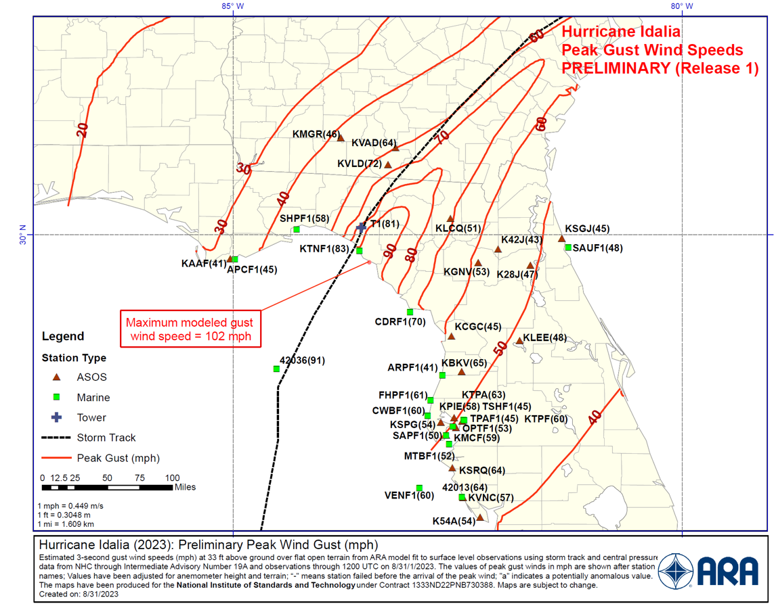
Hurricane Idalia – Wind Hazard Observations

Slide 6
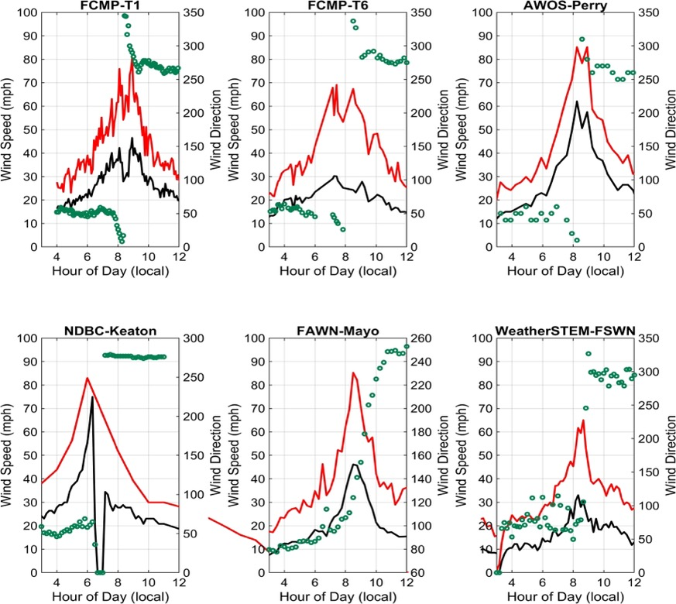
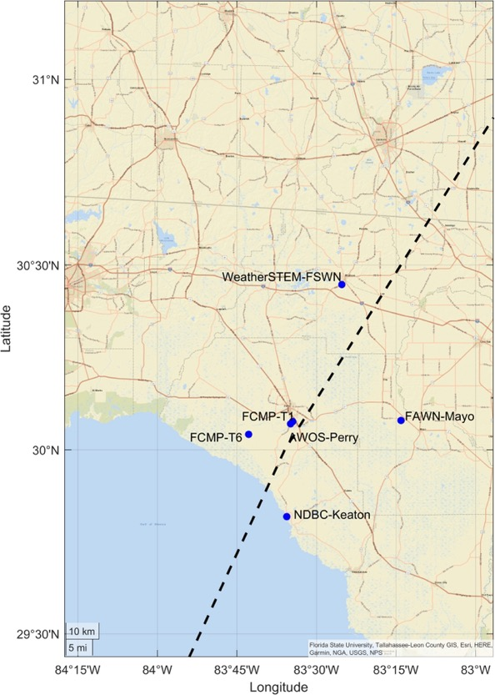
Hurricane Idalia – Surface Wind Observations
Selected surface wind observations in the landfall region on 30-Aug, including wind gusts (red), sustained wind speeds (black), and wind directions (green). Note: Precise averaging times for gusts and sustained winds vary slightly between stations.

Slide 7
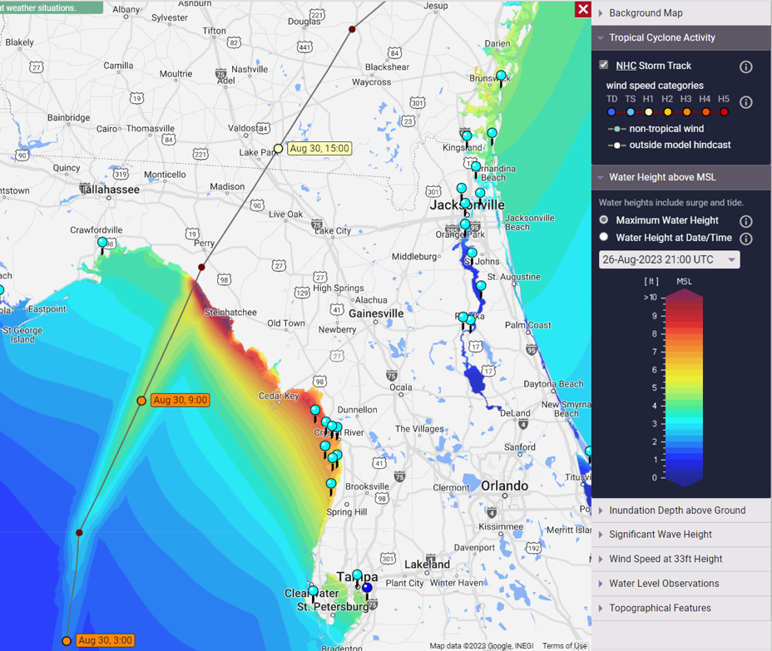
Storm Surge relative to Mean Sea Level
Notes:
Storm surge dictated by combined effects of the
- strong onshore wind field associated with the hurricane,
- tidal effects,
- the coastal geography - wide, gently-sloping continental shelf, and the
- concavity and low-lying coastal features of the Big Bend.

Slide 8
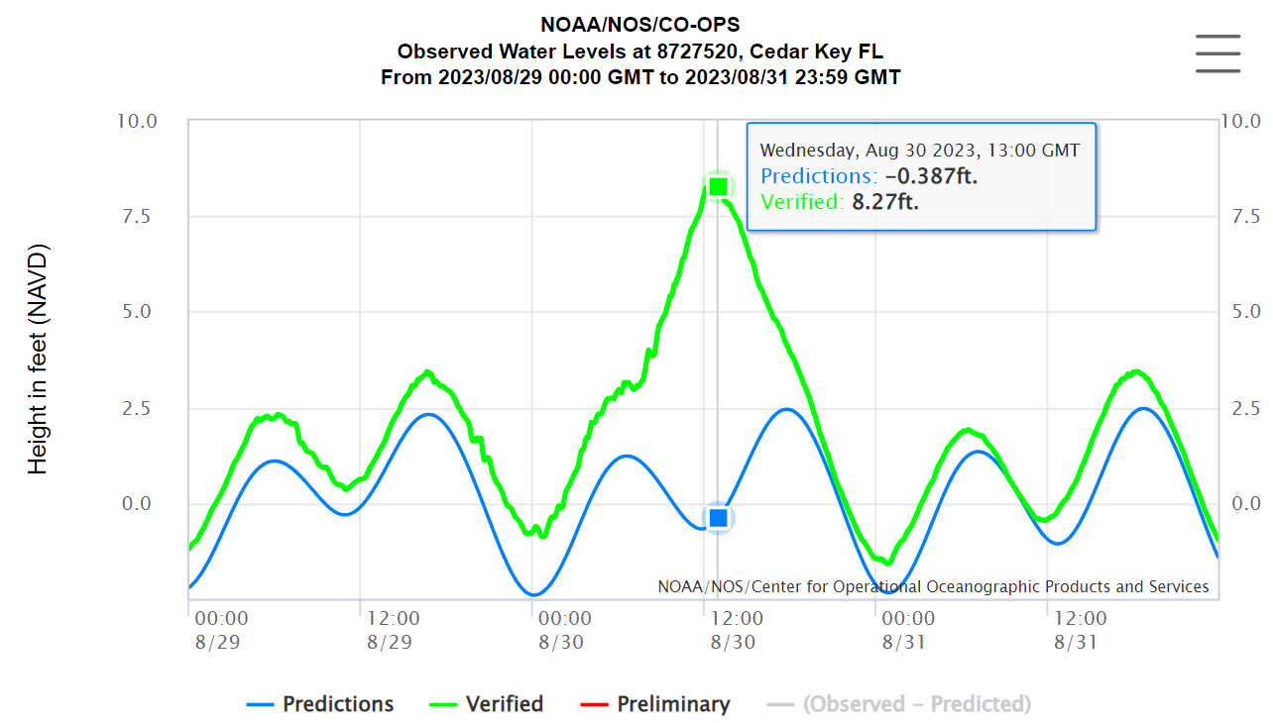
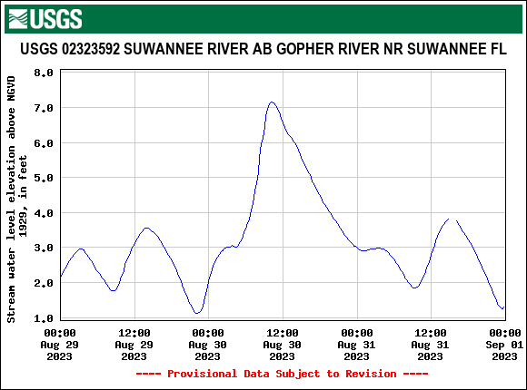

Slide 9
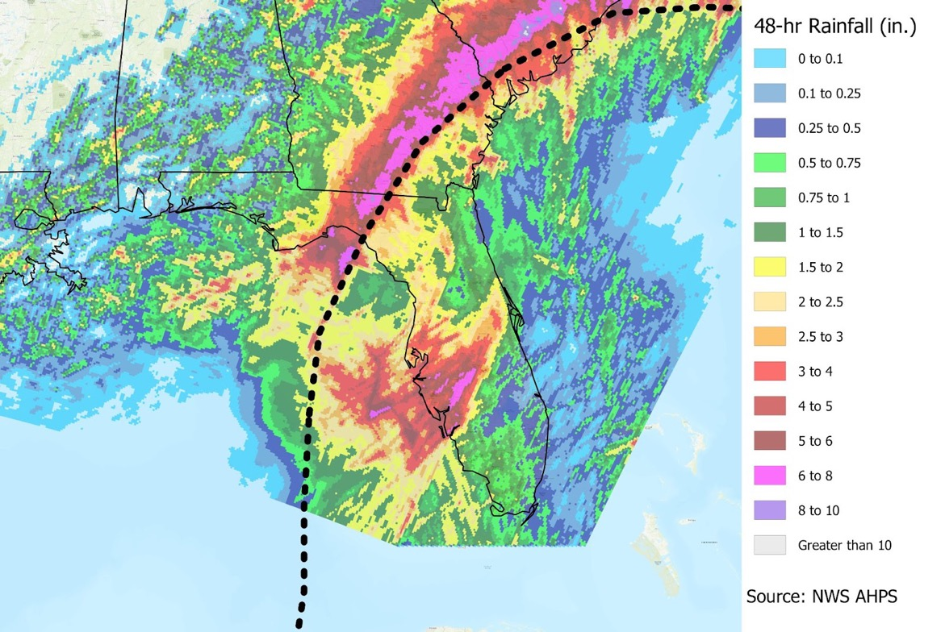
Idalia’s Rainfall Intensity
Notes:
Maximum total rainfall across a 48-hr period during Idalia’s passage was estimated at
- almost 10 inches in swaths near St. Petersburg, FL and
- along the storm’s track from the Florida panhandle and into portions of Georgia and South Carolina

Slide 10
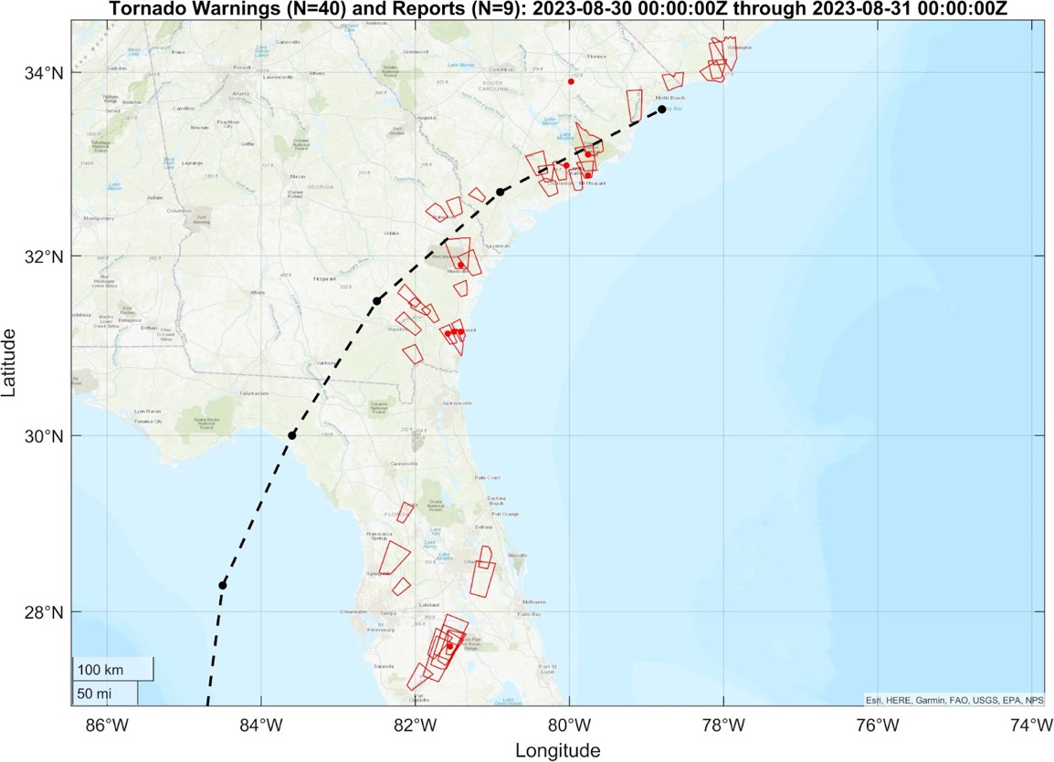
Tornado Warnings and Sightings
Notes:
NWS issued 40 tornado warnings and 9 tornadoes were reported (Fig. 2.9). The
NWS confirmed 13 tornadoes, all rated EF0 or EF1 using the Enhanced Fujita Scale (NWS).

Slide 11
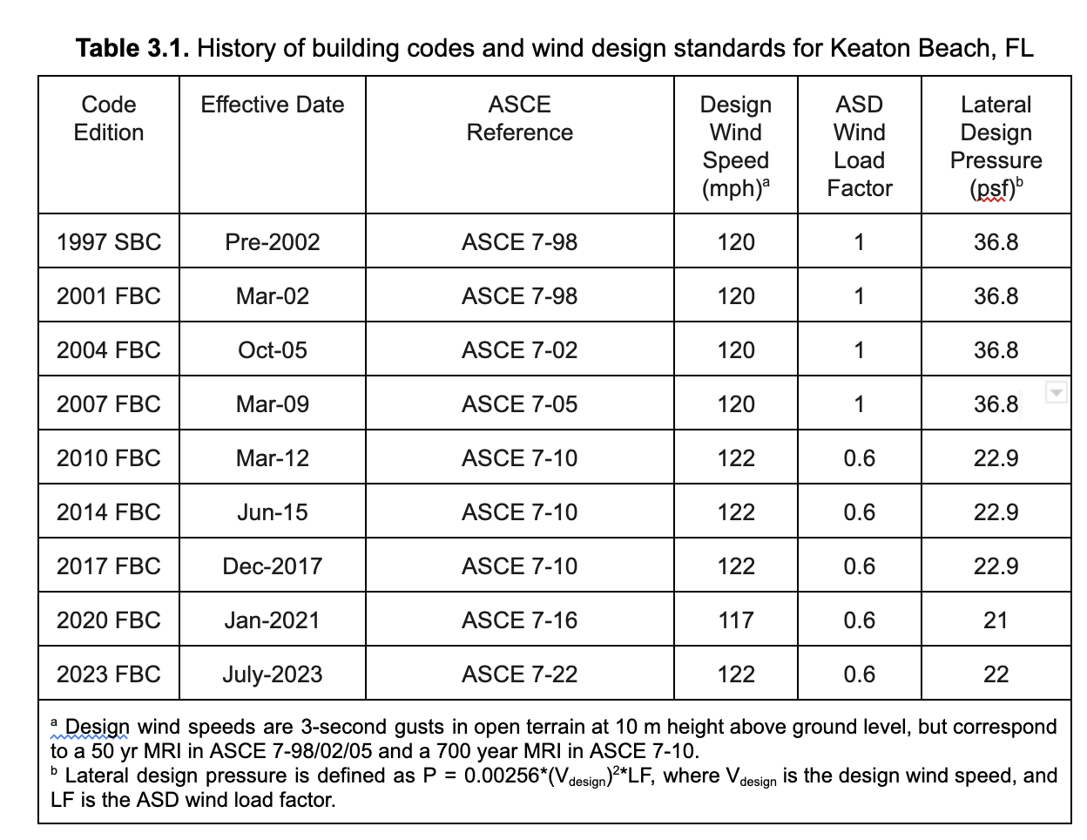
Local Building Codes Provisions - History
Notes:
In the landfall region, design wind speeds are 120 mph or less, the lowest in all of the state. For comparison, the allowable stress design level lateral wind pressure has dropped from the 37 psf established in the ASCE 7-98 to 22 psf in ASCE 7-10 and subsequent editions.
regulate most building construction: (1) the Florida Residential Code and (2) the Florida Building Code. While the Florida Residential Code provides regulations and guidance for the construction of one and two-family dwellings, the Florida Building Code addresses all other permanent buildings and structures. The Florida Building Code, released in 2010, was primarily based on the 2009 International Building Code, which did not incorporate the specifications of ASCE 7-10 at that time. From 2012, the ASCE 7-10 served as the foundation of the minimum structural design provisions of the Florida Building Code. See Table 3.1 for the history of code adoption in the landfall region and how the design pressure has changed with time.

Slide 12
FBC Changes after Hurricane Charley (2004)
Improved wood to masonry wall interfaces
Improved roof tile attachment
Adoption of wind-rated resistance of asphalt shingles
Required roof deck re-nailing when reroofing
Adoption of wind pressure criteria for soffits
Adoption of wind pressure labels for windows, garage doors, and shutters.
Notes:
All major structures are required to be designed to resist the predicted forces associated with a 100-year storm event. the lowest horizontal structural member of the building is placed at an elevation above the predicted breaking wave crest, termed the 100-year storm elevation.
Notably, there is no CCCL in Big Bend, as it governs only sandy beaches.

Slide 13
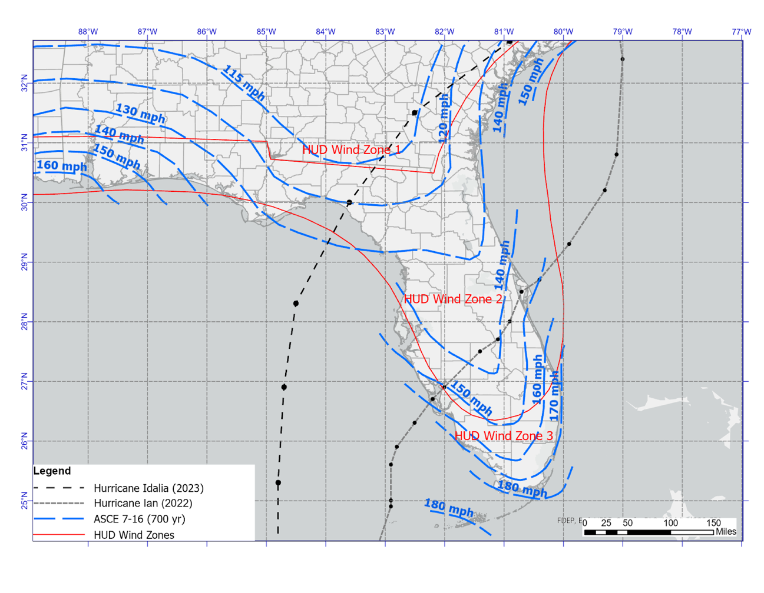
Notes:
Design wind speeds in Florida for ASCE 7-16 Risk Category II buildings (blue) and HUD-regulated buildings (red).

Slide 14
Florida Coastal Construction Control Line
Idalia best track with respect to the Florida Coastal Construction Control Line (2022). The CCCL is absent in the landfall region.

Slide 15
Post-Idalia Assessments
Two triage assessments performed
Date | September 1, 2023 | September 8, 2023
Personnel | (2) UF personnel, led by co-PI Gurley | (4) UF personnel, led by PI Prevatt
Locations Assessed | Steinhatchee, Dark Island, Keaton Beach, Dekle Beach, Ezell Airstrip neighborhood | W of Jasper, SW of Live Oak

Slide 16
Dr. Gurley and Dr. Ferraro Survey
Steinhatchee
Dark Island
Keaton Beach
Dekle Beach
Ezell Airstrip
1 September 2023
Wind-only damage
Primarily loss of roof cover (shingles or old metal roofs)
Most structures had little to no observable roof cover loss
Roof cover loss was almost exclusively to older buildings
All elevations of subject buildings typically not available, so unseen damage is very likely
Debris impact damage evident
Window damage was observed. Pressure vs debris not assessed
Roof decking damage was observed but infrequent, and only older construction
Overall observation is that coastal wind damage is consistent with that expected for a Cat 1-2 event, but it is much less frequent or severe than Cat 3 expectations. (This is independent of any storm surgedamage)

Slide 17
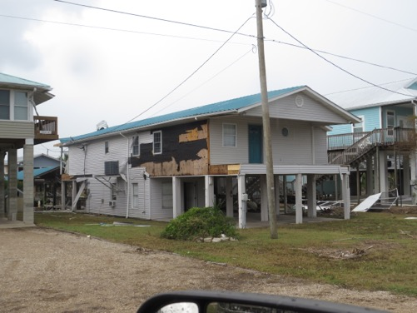
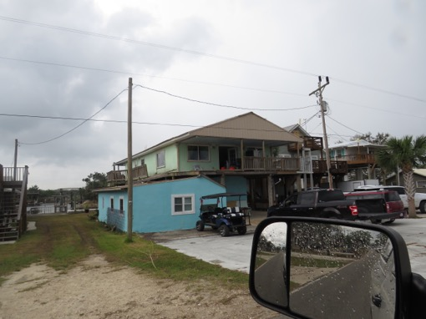
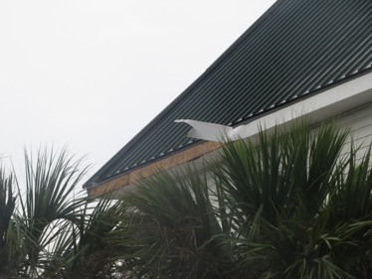
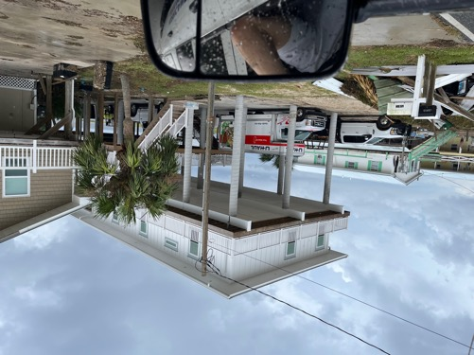
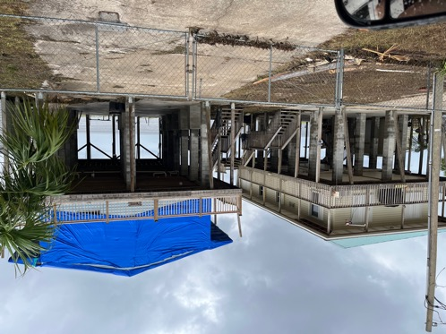
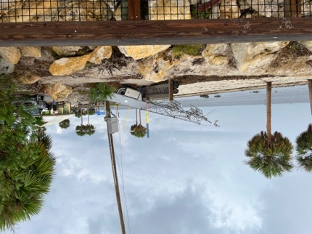
Keaton Beach

Slide 18
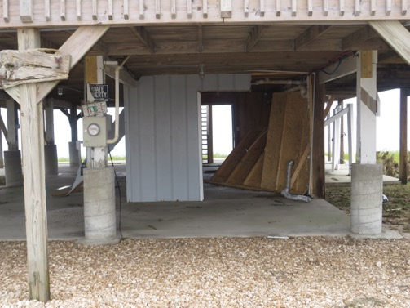
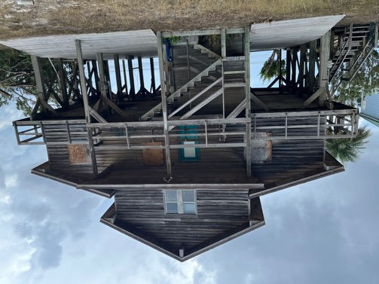
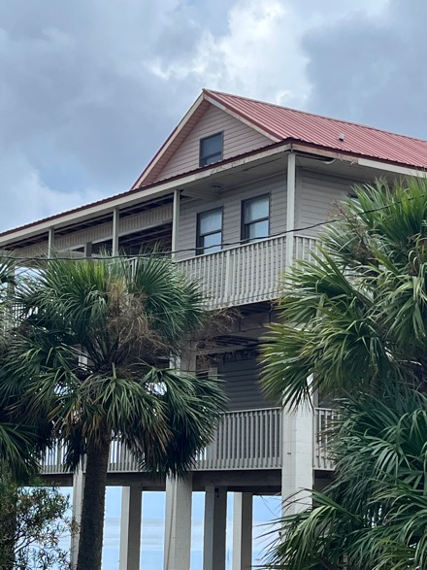
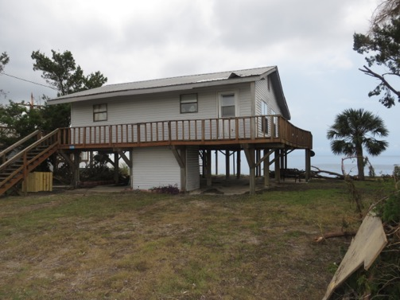
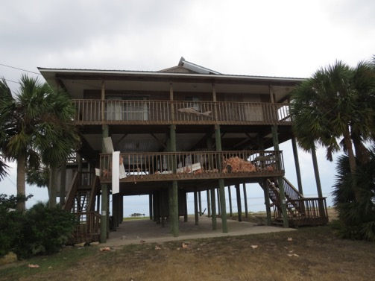
Dark Island

Slide 19
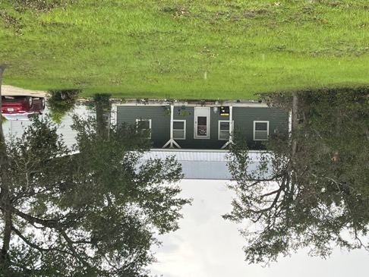
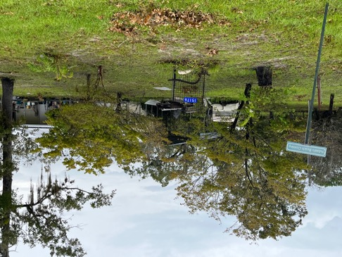
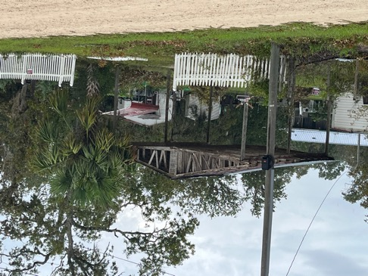
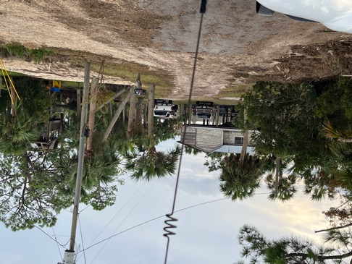
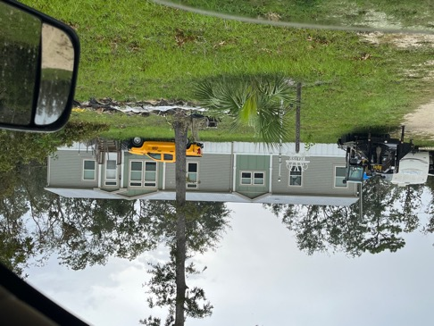
Ezell Airstrip Neighborhood

Slide 20
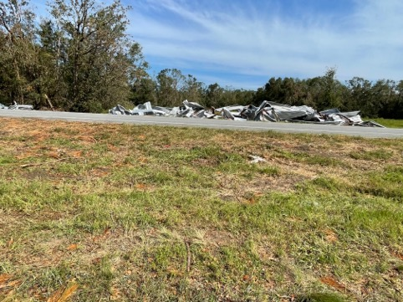
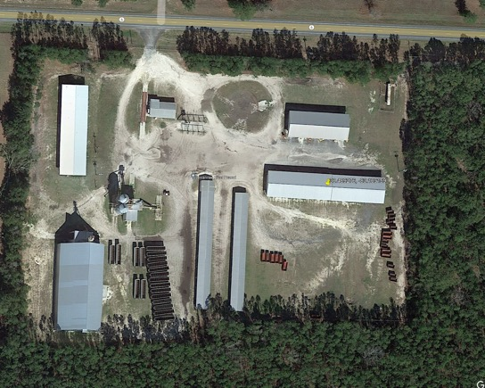
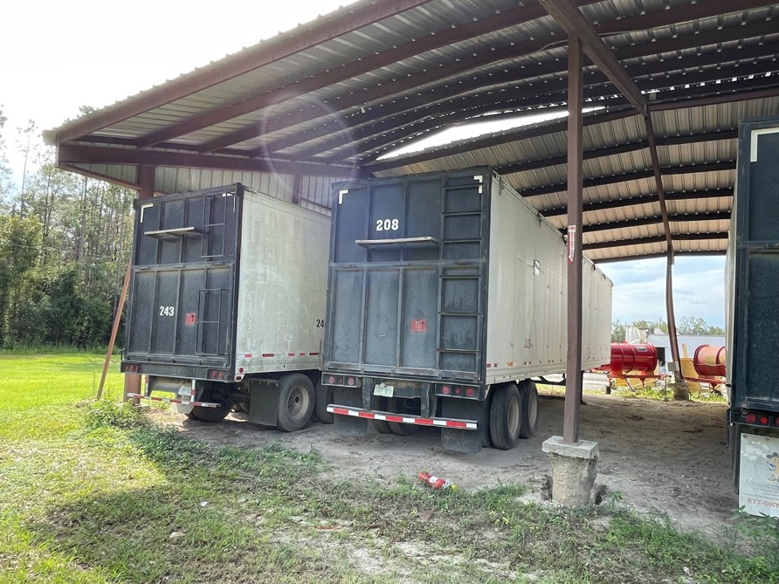
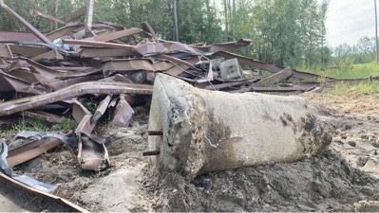
Suwanee R. Peanut Co.

Slide 21
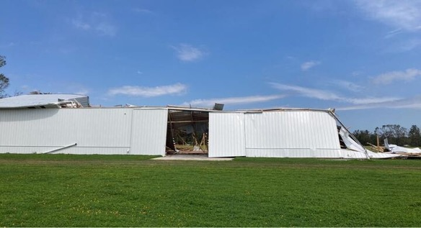
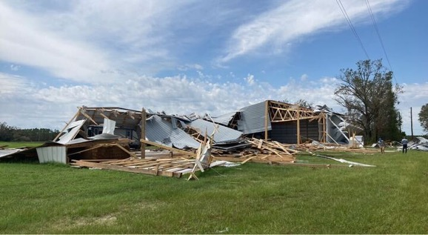
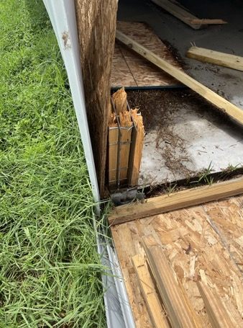
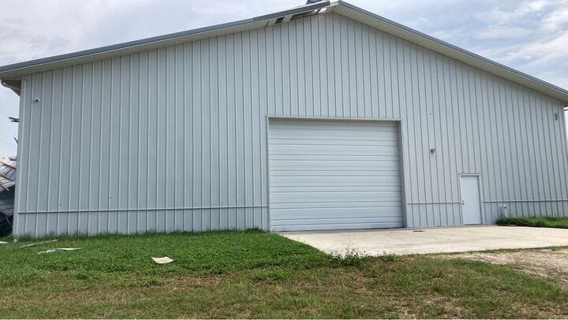
Polo Hay LLC

Slide 22
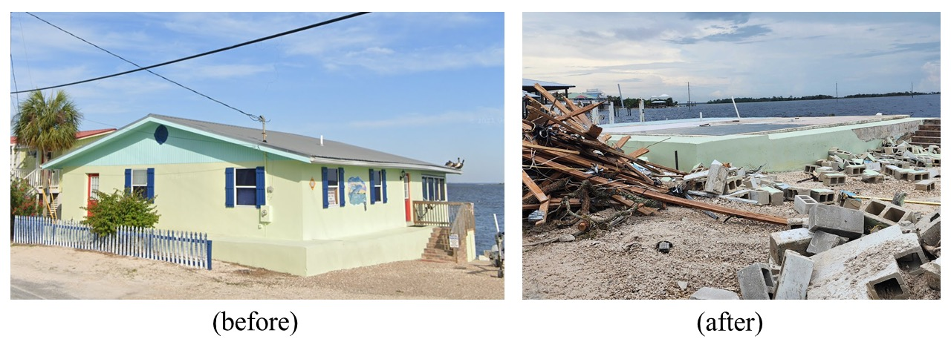
Case Study - #1
Complete destruction of single-story, concrete masonry home constructed in 1970.
(Horseshoe Beach, FL)
Notes:
Complete loss of single-story unreinforced concrete masonry house in Horseshoe Beach, FL (Source: Nina Stark, Rutgers University via DesignSafe-CI Slack).

Slide 23
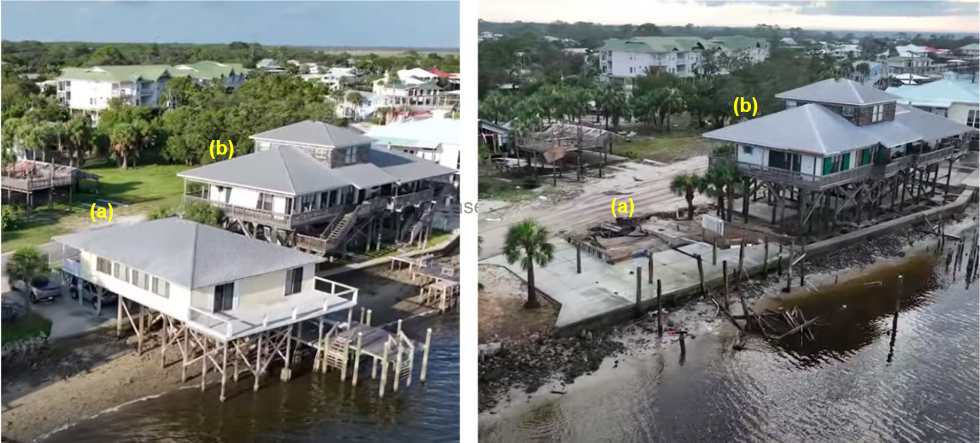
Case Study - #2
Complete loss of a building (a) in Horseshoe Beach, FL. Failed (broken and withdrawn) foundation members (piles) can be seen. Home was built in 1937 and was elevated ~6 ft above grade. Building (b) was constructed in 1994 and elevated ~10 ft above grade.
Notes:
The elevated wood-frame home that was washed away (a), was constructed in 1937 and elevated approximately 6 ft above grade.
The elevated home that is still standing was constructed in 1994 and was elevated approximately 10 ft above grade (Source: WXChasing YouTube).

Slide 24
Case Study - #3
Wall and window damage likely due to surge (Horseshoe Beach, FL)

Slide 25
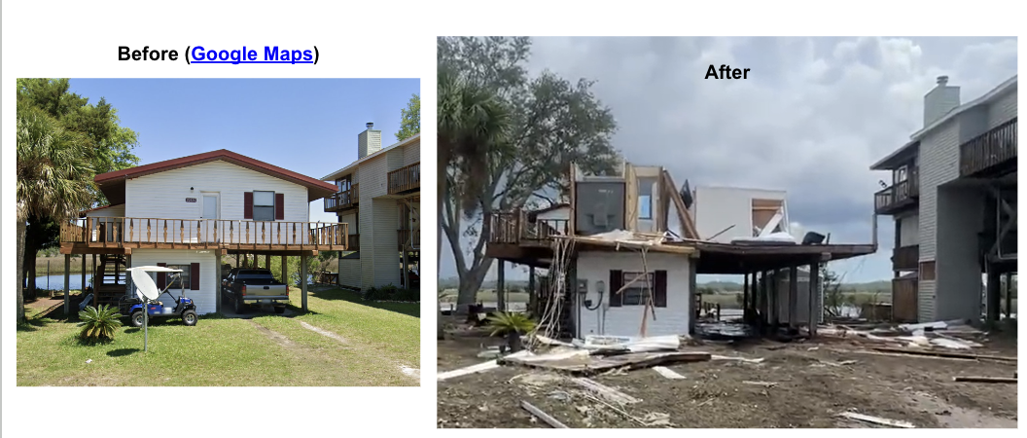
Case Study - #4
Structural roof damage to a wood-frame home constructed in 1982, elevated approximately 7 ft above grade. An adjacent home, constructed in 1994, only suffered minor wall cladding loss. (Keaton, Beach, FL)

Slide 26
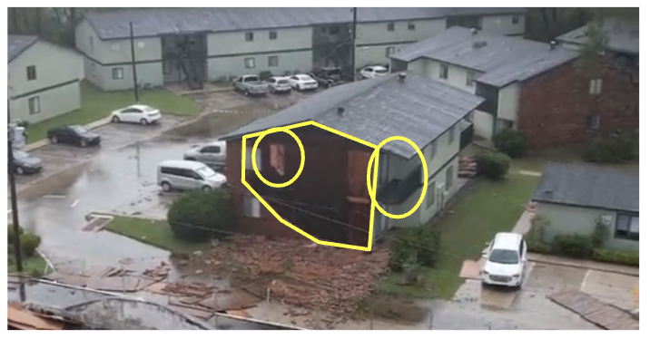
Multi-family Dwellings
Extensive facade (brick) damage, limited sheathing damage exposing insulation, and loss of balcony end wall on an apartment building in Perry, FL.

Slide 27
Category | Damage Observed
Single-Family Residential Buildings | Pre-1994 houses predominantly damaged, at or near grade. Roof cover and wall cladding losses
Multi-Family Residential Buildings | Brick building cladding failures, roof cover failures
Commercial Buildings | MBMA building total collapse, gas station canopies, storm surge damage to coastal structures,
Farm Buildings | A few total collapse of wood, steel framed buildings
Healthcare/Medical Facilities | No damage observed
Schools | Failures of metal roofing, & asphalt shingle roofing
Government Facilities | No damage observed
Mobile/Manufactured Homes | Few damage reports – including homes floated off foundation by storm surge
Critical Facilities | Fire Station, Cedar Key – Accessory structure
Historical Buildings | No damage observed
Religious Institutions | 1 flooded church in Horseshoe Bend, 2 roofing failures from churches (Perry and Jasper, FL)

Slide 28
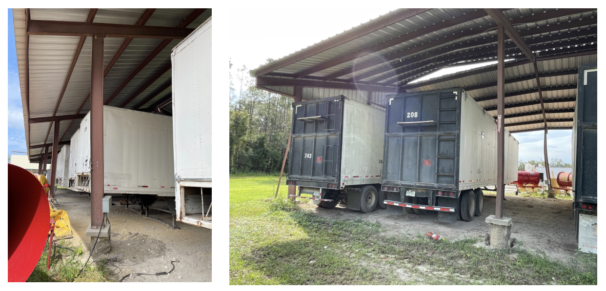
Farm Buildings
Column-foundation pull-out capacity failure.(Source: UF Triage Assessment).
Notes:
Low wind speed failures (80-90 mph)

Slide 29
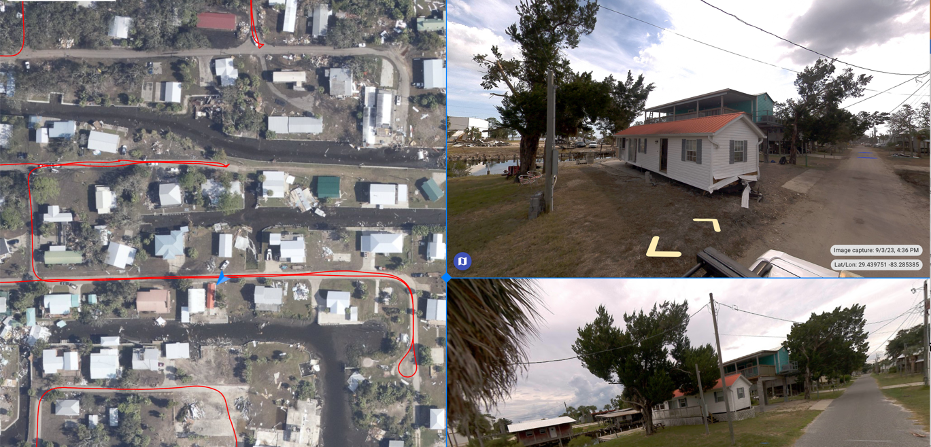
Additional Visual Data Available

Slide 30
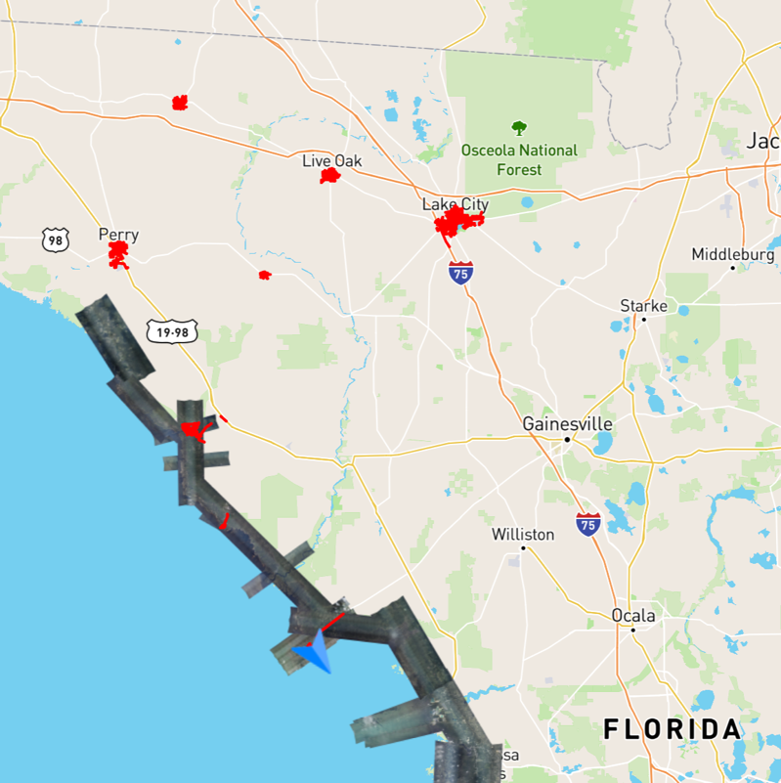
Before/After Imagery by SiteTour360
Approximately 450 miles of data
Cedar Key
Steinhatchee
Horseshoe Beach
Mayo
Perry
Lake City
Live Oak
Madison
(Access Viewer).

Slide 31
Summary
Hurricane Idalia was one of the lowest-impact major hurricanes to landfall in the state of Florida in recent years – due to rural location
Moderate peak wind speeds (70 to 90 mph), caused damage to structures well inland from coast, as far as Jasper, FL near to the Georgia border.
We do not recommend further investigation given small numbers of damaged buildings - anticipate limited opportunity to derive new knowledge
Opportunities for bolstering community resilience:
Risk perception and behavioral response to risk information (wind speeds 90 mph)
Policy advocacy
Coastal Building Elevations/ Blue Sky Study
Reconsider: Code Exemptions for Buildings on Agricultural Property
Vulnerability of Manufactured and Mobile Homes (especially in coastal locations)
Notes:
Hurricane Idalia was one of the lowest-impact major hurricanes to landfall in the state of Florida in recent years, due to its landfall in a rural region dominated by farming and other agricultural activities. Nonetheless, and despite the moderate peak wind speeds (70 to 90 mph), wind damage to structures occurred well inland, extending as far as Jasper, FL near to the Georgia border. The observed level of damage to buildings and infrastructure caused by Hurricane Idalia represents the damage expected by this moderately strong event. Given the small number of damaged buildings, there are limited opportunities to generate new knowledge, from a hazard engineering perspective. However, there are opportunities to use this event to bolster the resilience of these communities through research on risk perception and behavioral responses to risk information, as well as policy advocacy, in the following areas:

Slide 32
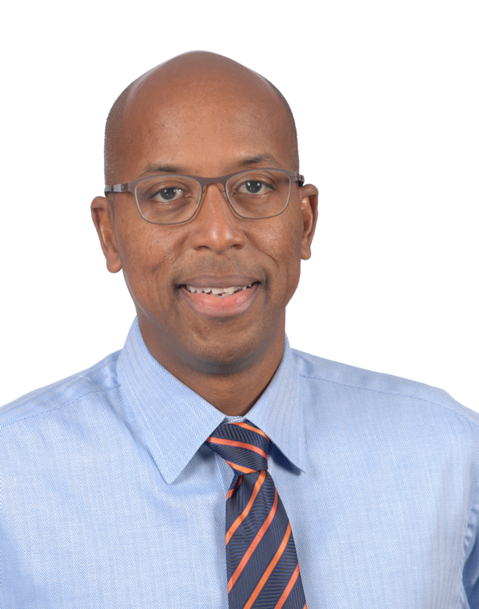
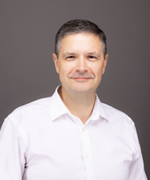
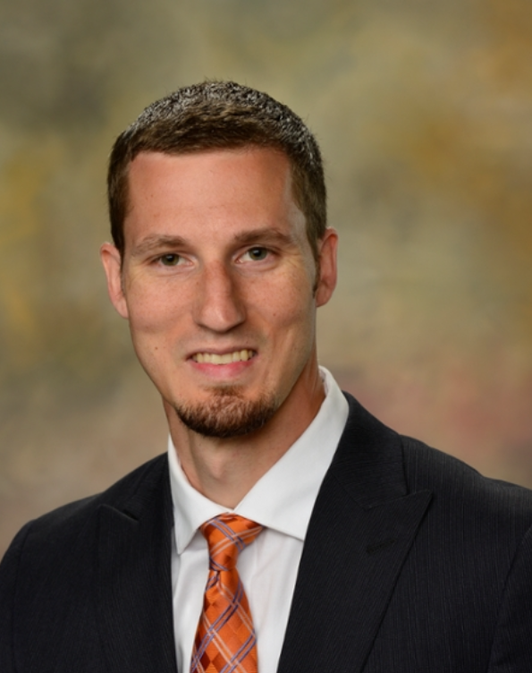
Thank you for your Time!
David O. Prevatt, PE (FL)
University of Florida
Kurtis R. Gurley
University of Florida
David B. Roueche
Auburn University

